Slide 1
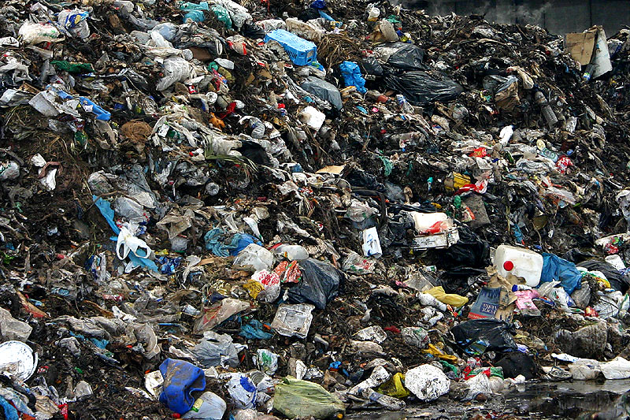
Recycling in the District Office Offices of Facilities & Engagement May 9, 2014

Slide 2
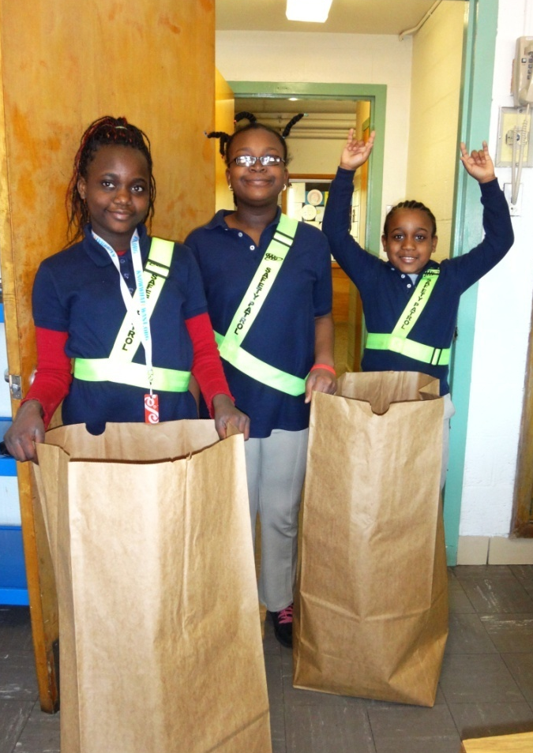
Overview
MD law: counties must develop recycling strategy all school systems
Recycling reduces trash, conserves natural resources
Recycling is one part of a larger sustainability effort at City Schools
Let’s lead by example!

Slide 3
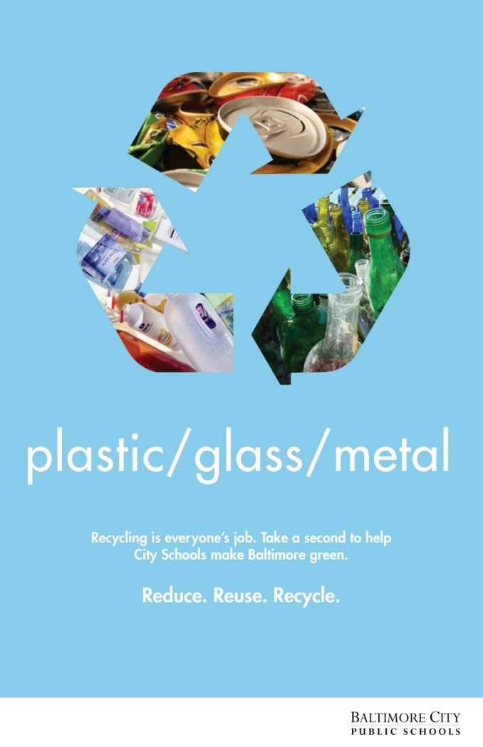
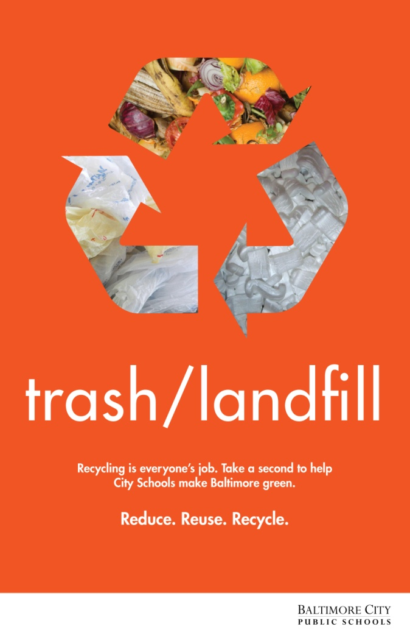
Consistent Practices

Slide 4
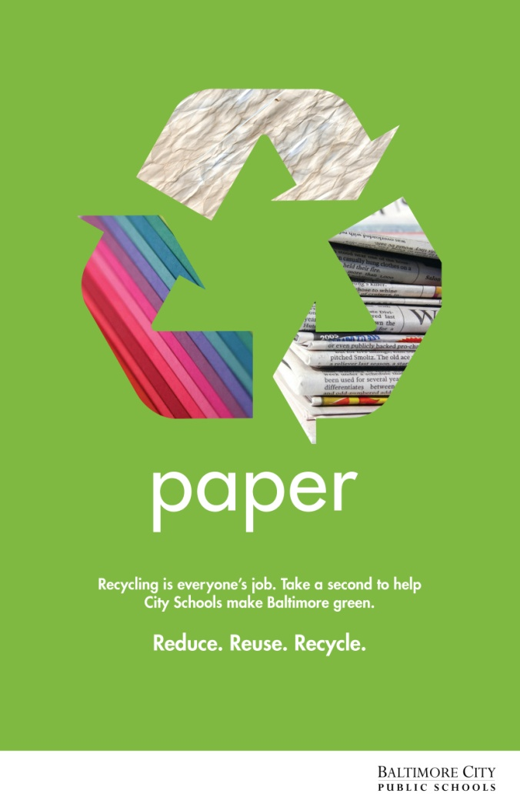
Office paper
Envelopes & mail
Colored paper
Cardboard
Newspaper
Magazines & catalogs
OK: staples
Not OK: binder clips, plastic linings, waxed paper

Slide 5
Shredding
Can be done:
In your office
In the mail room on the first floor
To save money, try to avoid hiring outside vendors

Slide 6
“Single-stream” recycling
Cans, plastic bottles, glass bottles, newspaper, paper, cardboard
City picks up our recycling twice per week
No cost to City Schools
Reduced trash pick-up

Slide 7
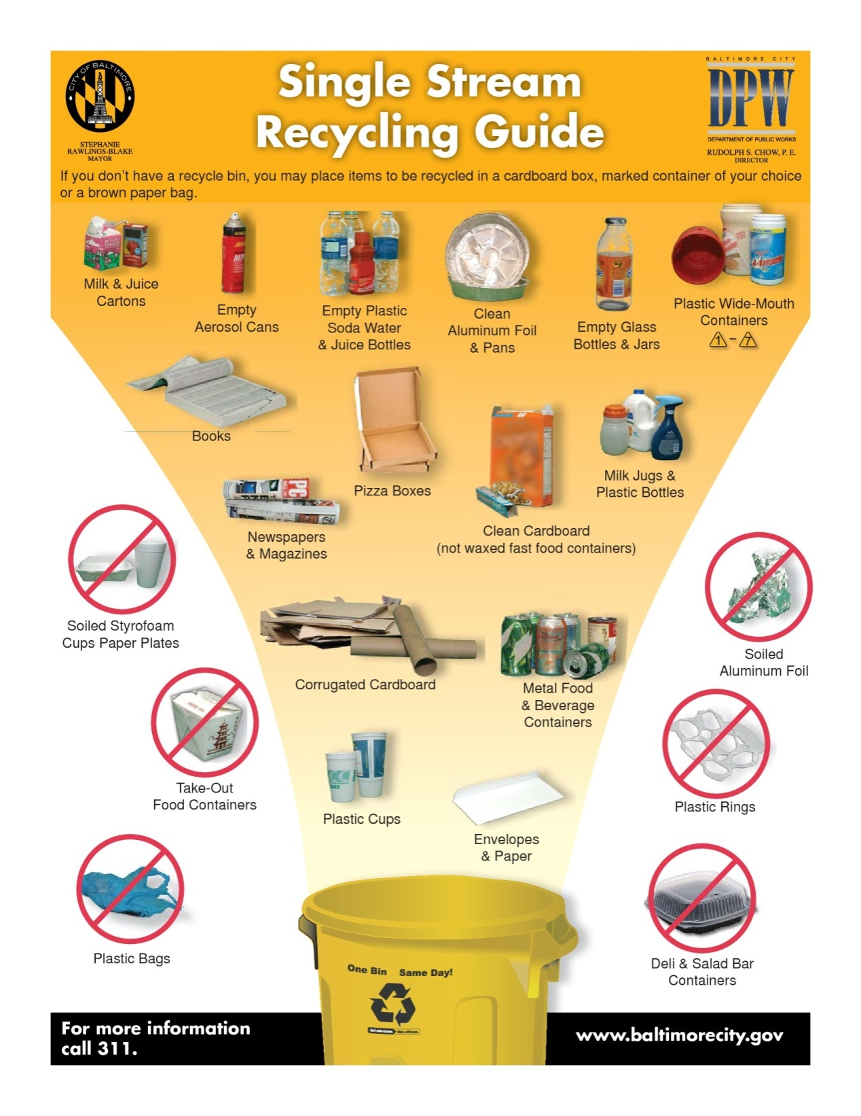

Slide 8
Food
Deli and salad bar containers
Plastic bags
Broken items (e.g. binders, furniture)
Used paper towels
Styrofoam*
Bubble wrap*
* Only recycled at City collection centers

Slide 9
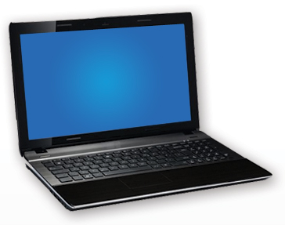
Electronics
Computers
Monitors
Cell phones
Fax machines
Call Information Technology Dept (ITD) for assessment and recycling
Toner – can be recycled via vendor

Slide 10
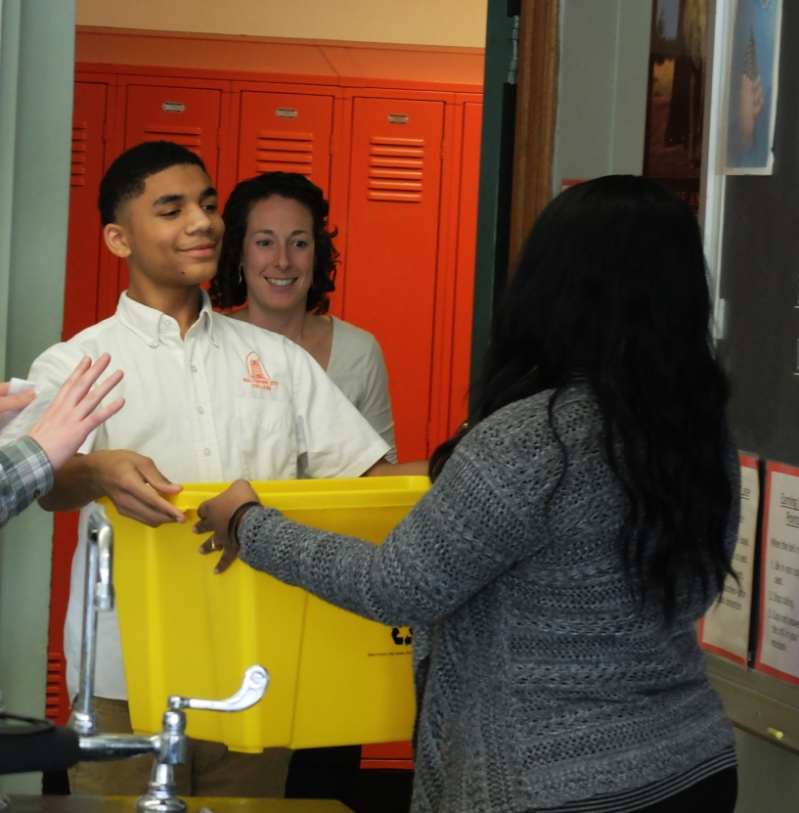
Resources
Toolkit on City Schools Inside www.baltimorecityschools.org/recycle
See how one school is recycling http://www.baltimorecityschools.org/Page/25560
Champion in each office
Staff support:
Raj Bachubhay, energy specialist
Joanna Pi-Sunyer, green schools coordinator
Antoine McIver, manager, maintenance & operations

Slide 11
Energy Conservation
Turn off lights when an area is left unoccupied for more than 10 minutes
Turn your computer monitor off when it is not in use for more than 30 minutes
Turn off machines and equipment when not needed and unplug all unused equipment
Minimize the use of personal appliances (e.g. microwaves, coffee pots, heaters)
Set up two-sided printing as your default print mode to conserve paper

Slide 12
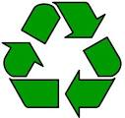
40% of what goes into our landfills today is recyclable paper, Each year, American throw away 25,000,000,000 Styrofoam cups. Even 500 years from now, the foam coffee cup you used this morning will be sitting in a landfill. In 2010, Americans threw away enough paper to cover 26,700 football fields in paper three feet deep. The average person in the United States generates more than 4 pounds of waste daily.

